Slide 1
Introduction to Data Structures
Common data structure in python

Slide 2
What are Data Structures?
Data structures are ways of organizing and storing data so that it can be accessed and worked with efficiently.
They are essential for managing large amounts of data and allow for effective data retrieval and manipulation.

Slide 3
Why are Data Structures Important?
Efficient Data Management: They allow for faster data processing and retrieval.
Optimized Performance: Well-chosen data structures reduce the time complexity of algorithms.
Data Organization: Help maintain order, especially when handling large datasets.
Memory Utilization: Good data structures minimize memory wastage.

Slide 4
Python's Built-in Data Structures
Lists: Ordered, mutable collection.
Tuples: Ordered, immutable collection.
Sets: Unordered, mutable collection of unique elements.
Dictionaries: Unordered, mutable collection of key-value pairs.

Slide 5
Introduction to Lists in Python
Understanding Python's Most Versatile Data Type

Slide 6
What is a List in Python?
A list is a collection of items in a particular order.
Lists can hold items of different data types.
Syntax: my_list = [item1, item2, item3, ...]
Lists are ordered, changeable (Mutable), and allow duplicate elements.
Lists are defined using square brackets[ ].

Slide 7
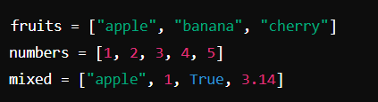
Creating a List
Lists can contain items of any data type.

Slide 8
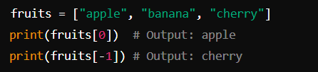
Accessing List Items
Access elements using their index.
Indexing starts at 0.
Negative indexing allows you to access elements from the end.

Slide 9
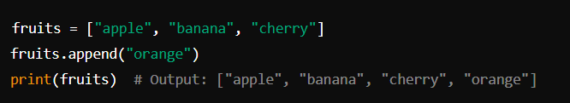
Adding Elements to a List
append() Method
Adds an element to the end of the list.
Syntax: list_name.append(item)
The append() method is used when you want to add a new item to the end of an existing list.
The list is modified in place, meaning the original list is updated.

Slide 10
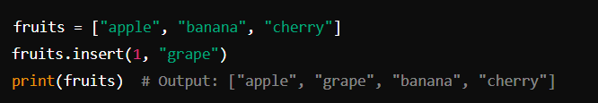
Adding Elements to a List
insert() Method
Inserts an element at a specified index in the list.
Syntax: list_name.insert(index, item)
The insert() method allows you to place an element at any position in the list.
The index is where the new item will be added, and the items after the specified index are shifted one position to the right.

Slide 11
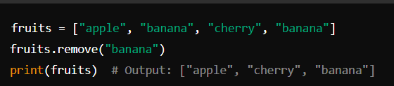
Removing Items from a List
Removing by Value:
remove(): Removes the first occurrence of a specified value from the list.
The remove() method finds the first instance of the specified value and removes it.
If the value is not found, a ValueError is raised.

Slide 12
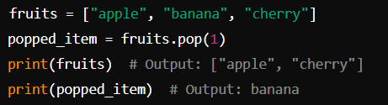
Removing Items from a List
Removing by Index :
Removes and returns the element at a specified index (or the last element if no index is provided).

Slide 13

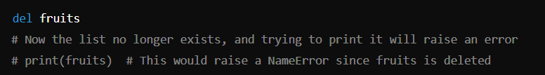
Removing Items from a List
del Keyword :
Deletes an element at a specified index or deletes the entire list.
Unlike pop(), del does not return the deleted element.

Slide 14
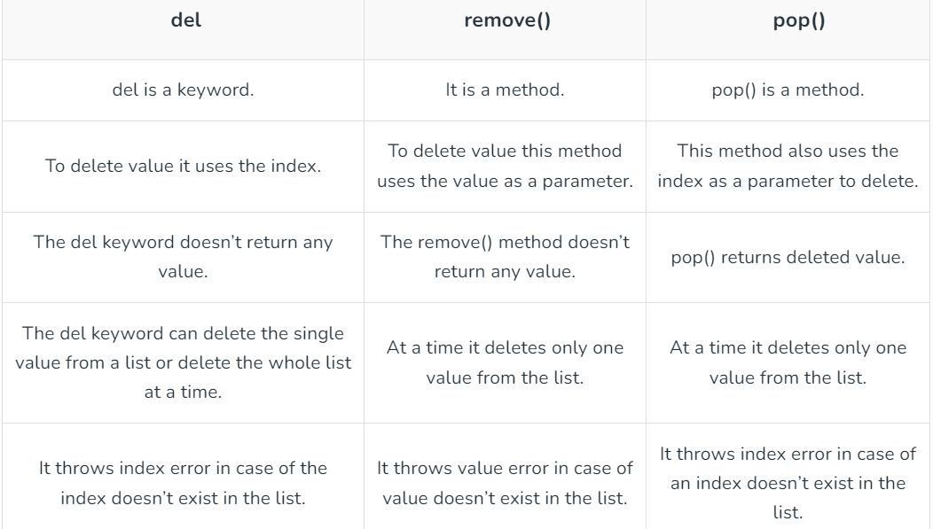
del V/S remove() the V/S pop()

Slide 15
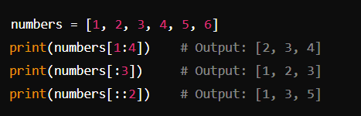
List Slicing
Slicing Syntax: my_list[start:end:step]

Slide 16
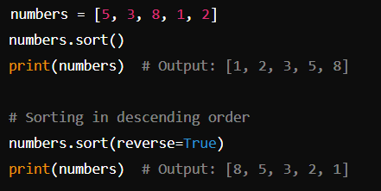
sort() Method
Sorts the list in ascending order by default. It can also sort in descending order.
Syntax: list_name.sort(reverse=False)
The sort() method modifies the list in place.
Use reverse=True to sort the list in descending order.

Slide 17

reverse() Method
Reverses the elements of the list in place.
Syntax: list_name.reverse()
The reverse() method changes the order of the elements in the list to the reverse of their current order.
It does not sort the list but simply reverses the order.

Slide 18
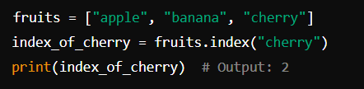
index() Method
Returns the index of the first occurrence of a specified value.
Syntax: list_name.index(item)
The index() method returns the index of the first occurrence of the specified value.
If the value is not found, it raises a ValueError.

Slide 19
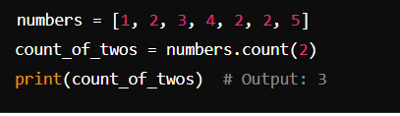
count() Method
Returns the number of times a specified value occurs in the list.
Syntax: list_name.count(item)
The count() method is useful for counting how many times a specific value appears in a list.

Slide 20
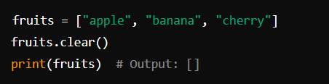
clear() Method
Removes all elements from the list, resulting in an empty list.
Syntax: list_name.clear()
The clear() method empties the list, removing all elements.
The list itself remains, but it becomes an empty list.

Slide 21

Nested Lists
A list can contain other lists as its elements.
Nested lists are useful for representing complex structures like matrices.

Slide 22
THANK YOU
HAPPY LEARNING!

